Slide 1

What Mr. Spock would possibly say about modern unit testing: pragmatic and emotional overview
Yaroslav Yermilov
Senior Software Engineer, EPAM Systems

Slide 2


About me
Yaroslav Yermilov
Senior Software Engineer, postgraduate
https://ua.linkedin.com/pub/yaroslav-yermilov/58/682/506
https://www.facebook.com/yaroslav.yermilov
https://twitter.com/yermilov17
fond of Java, complete code, big data, data science, Groovy

Slide 3
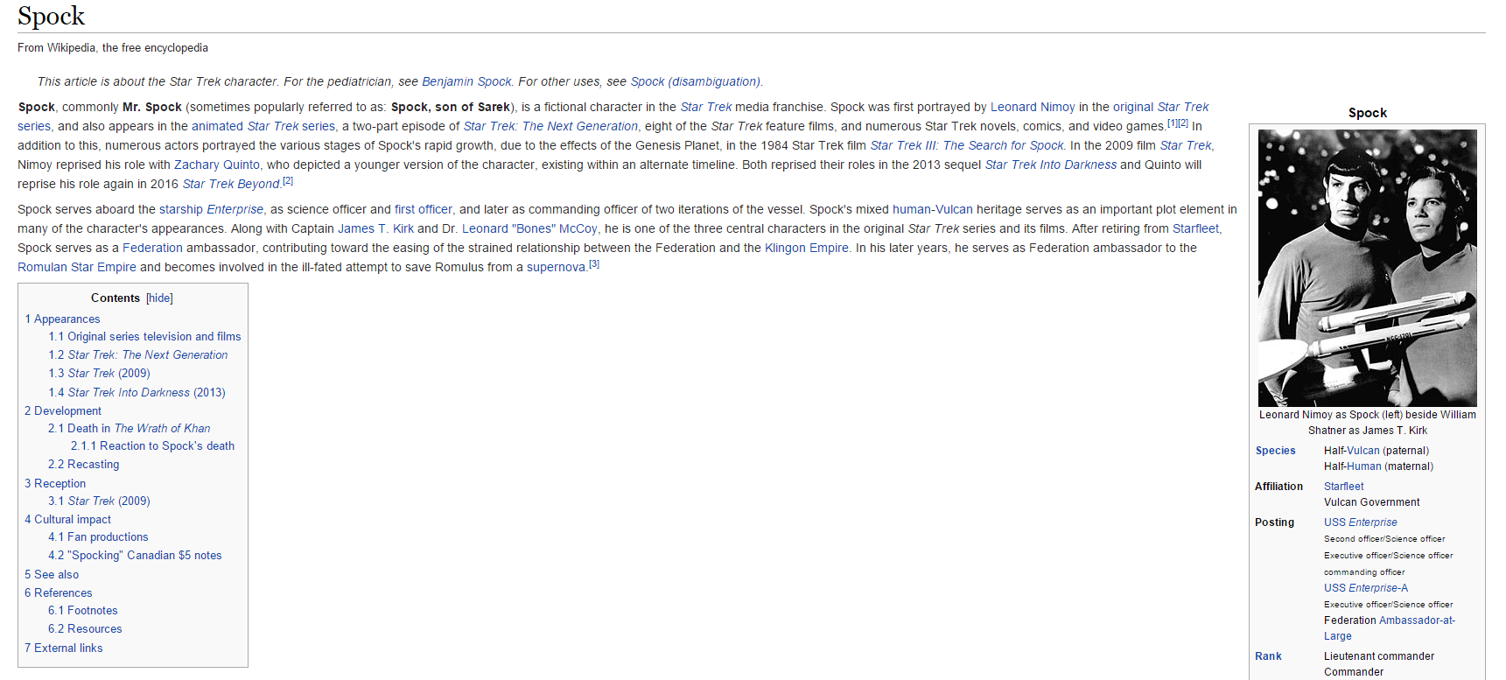
About Spock

Slide 4

What’s the problem?

Slide 5

Better to test before going to production

Slide 6
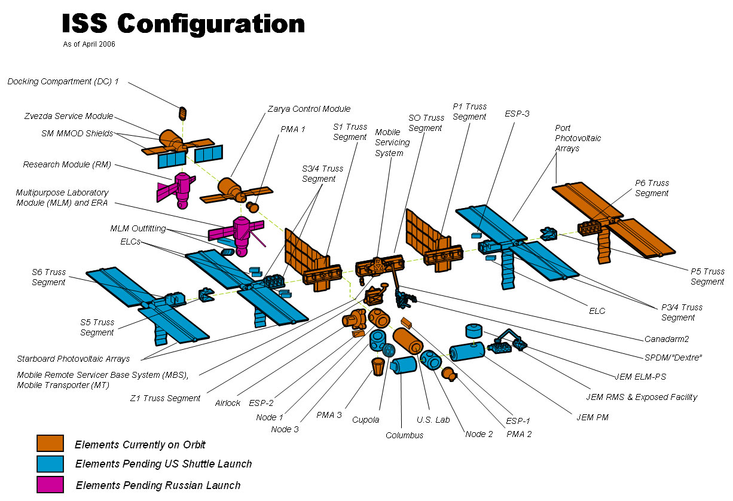
Firstly, to unit-test

Slide 7

So what?

Slide 8

JUnit?

Slide 9

JUnit on steroids?

Slide 10

TestNG?

Slide 11

Nothing?

Slide 12

Well, JUnit is great

Slide 13

But a little bit...

Slide 14
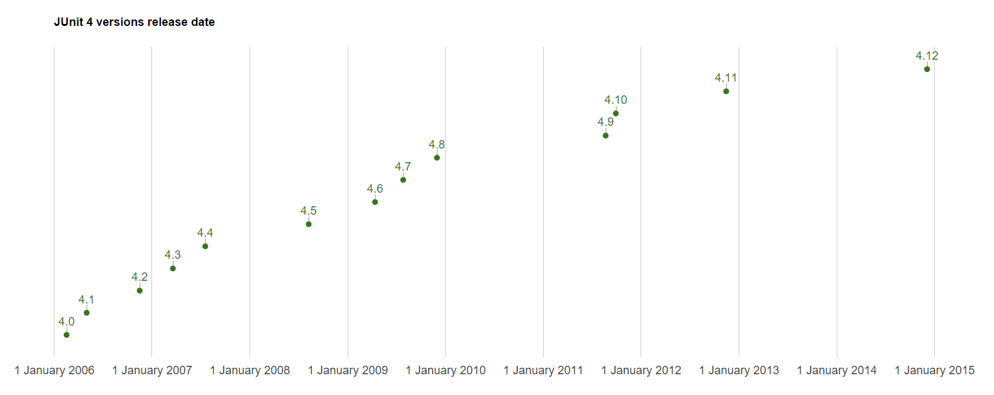
...stable?

Slide 15

So why don’t try Spock?

Slide 16
Why Groovy?
Groovy is the Java re-imagined
Have your ever think how Java 2.0 should look like?
Groovy has lots of features you even don’t think about, but after first taste you won’t be able to imagine development without them
Groovy is fully compatible with Java
Groovy has beautiful and highly expressive DSLs

Slide 17

Spock
Why Groovy?
Spock
JUnit
Groovy is the Java re-imagined
JUnit 5.0
Have your ever think how Java 2.0 should look like?
Spock
Groovy has lots of features you even don’t think about, but after first taste you won’t be able to imagine development without them
unit-testing
Spock
Groovy is fully compatible with Java
Spock
Groovy has beautiful and highly expressive DSLs

Slide 18

Spock is Enterprise ready

Slide 19
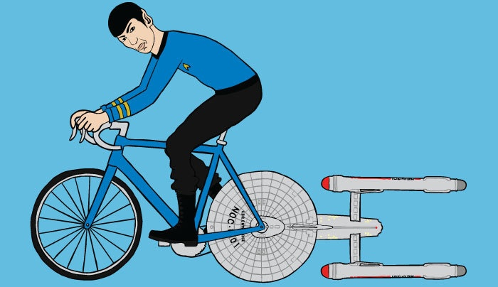
Let’s go!
https://github.com/yermilov/spock-talk

Slide 20
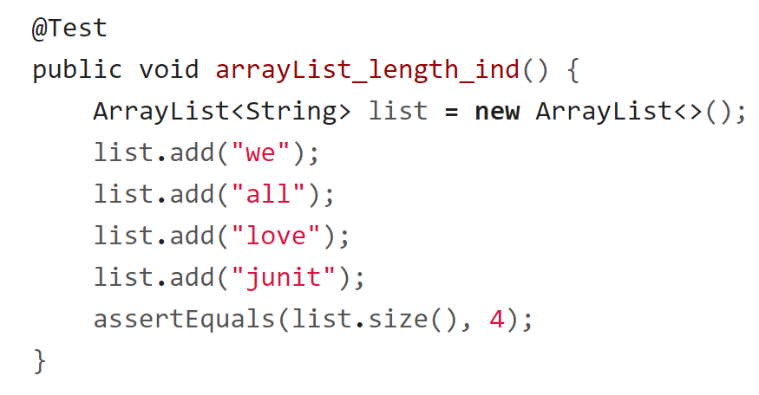
Every journey starts somewhere

Slide 21
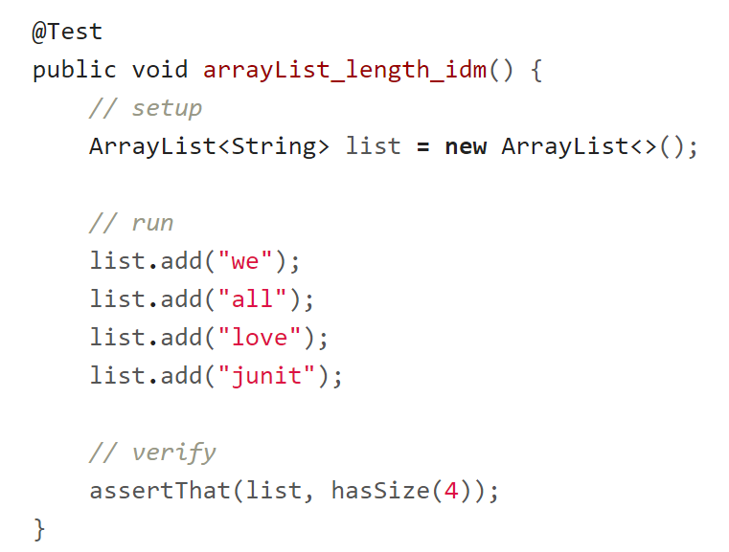
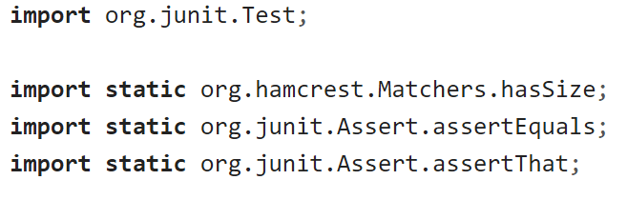
Every journey starts somewhere

Slide 22
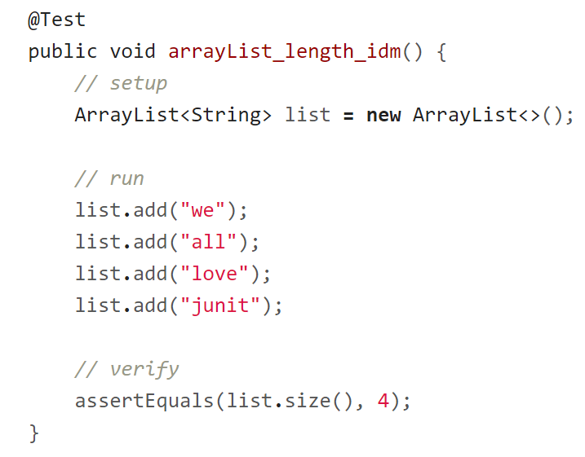
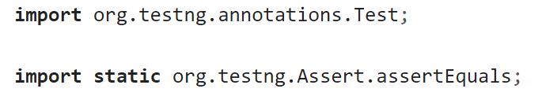
Every journey starts somewhere

Slide 23

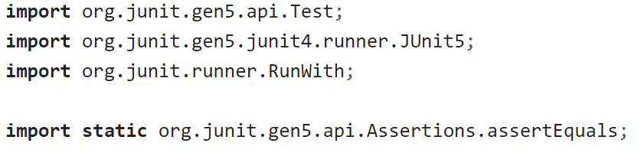
Every journey starts somewhere

Slide 24
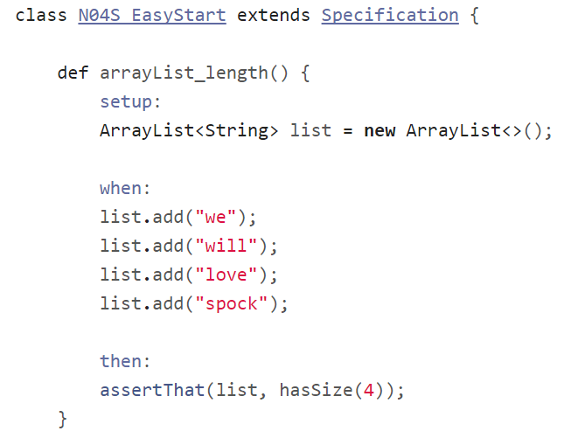
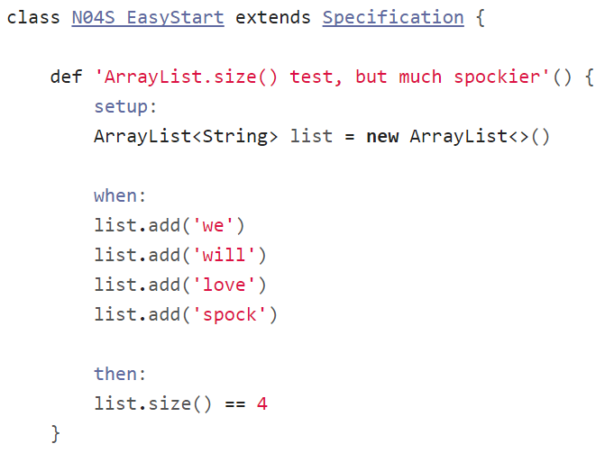
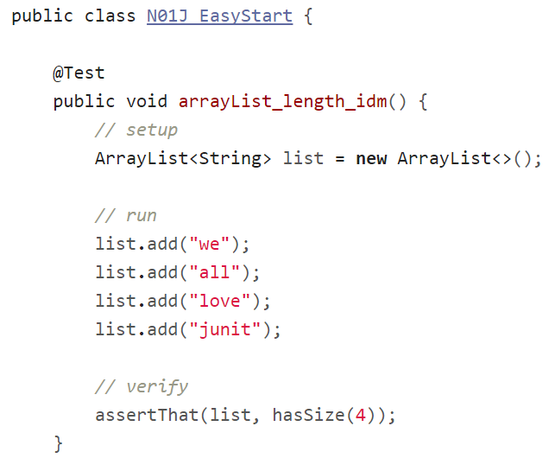
Every journey starts somewhere

Slide 25
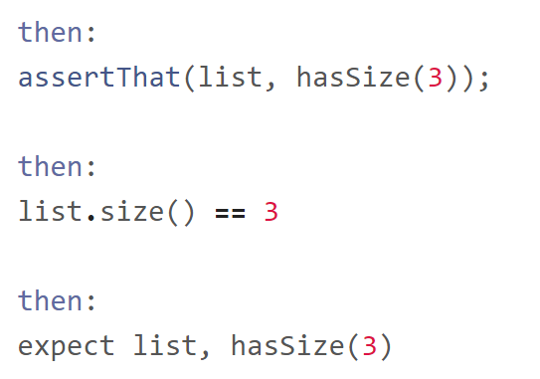
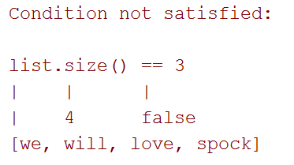
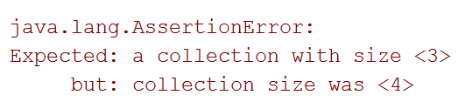
Assertions

Slide 26
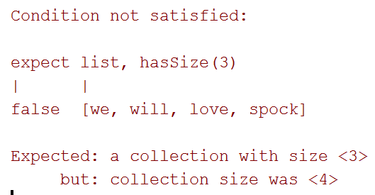
Assertions

Slide 27
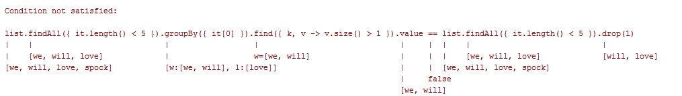
Assertions

Slide 28
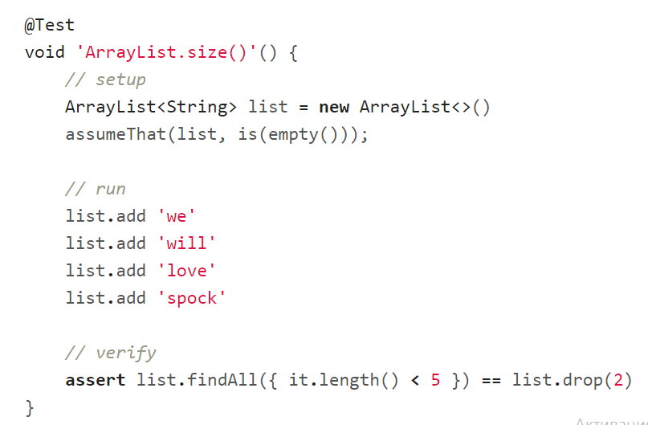
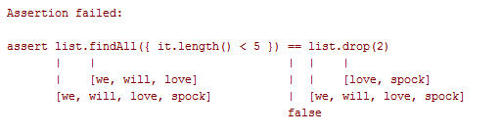
Assertions

Slide 29
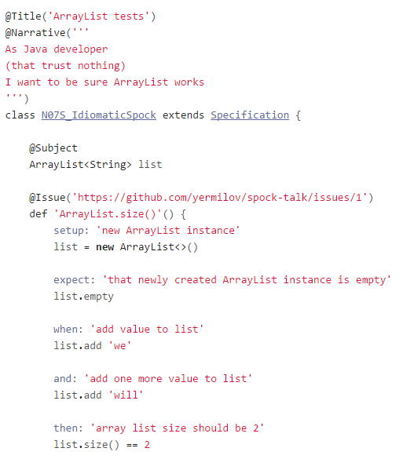
Idiomatic test

Slide 30
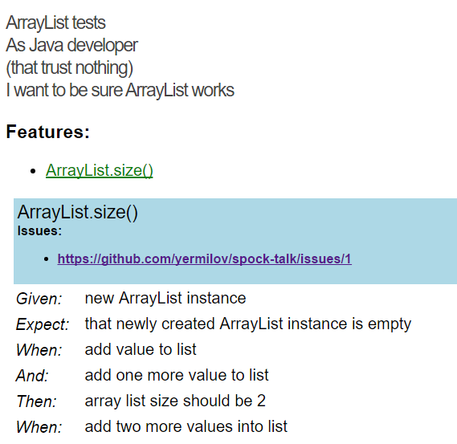
Idiomatic test

Slide 31

What’s next?
http://spockframework.github.io/spock/docs/1.0/index.html
http://meetspock.appspot.com/
https://github.com/spockframework
Just use it in your projects and enjoy!

Slide 32

Thanks!

